Slide 1
IIJA Orphan Well Grants
AOGCC is overseeing the IIJA Orphan Wells program for Alaska.
AOGCC has been awarded initial grant of $25 MM to develop the program and begin plugging, evaluating wells.
Expect to receive Formula Grants in coming years. Amount is dependent on allocation between other states.
Formula grants determined based on number of wells, number of jobs lost in the industry, cost to plug wells.

Slide 2
Alaska’s Orphan Wells Program
AOGCC is administering Orphan Well program for wells on State and Private lands within the state of Alaska.
Native Corporation lands are considered private lands for the purposes of IIJA Orphan Wells grants and are included in the State program.
BLM has a separate Orphan Well program for plugging wells on Federal lands.
Legacy Wells program in NPRA is separately funded and will continue to be administered by BLM.

Slide 3
Project Coordination
AOGCC is lead on interface with Dept of Interior and in administering the project according to IIJA rules and AOGCC regulations.
State DOT is administering contract.
OPMP is helping to coordinate between various state agencies and organizations. Will be point of contact for permitting requirements.

Slide 4
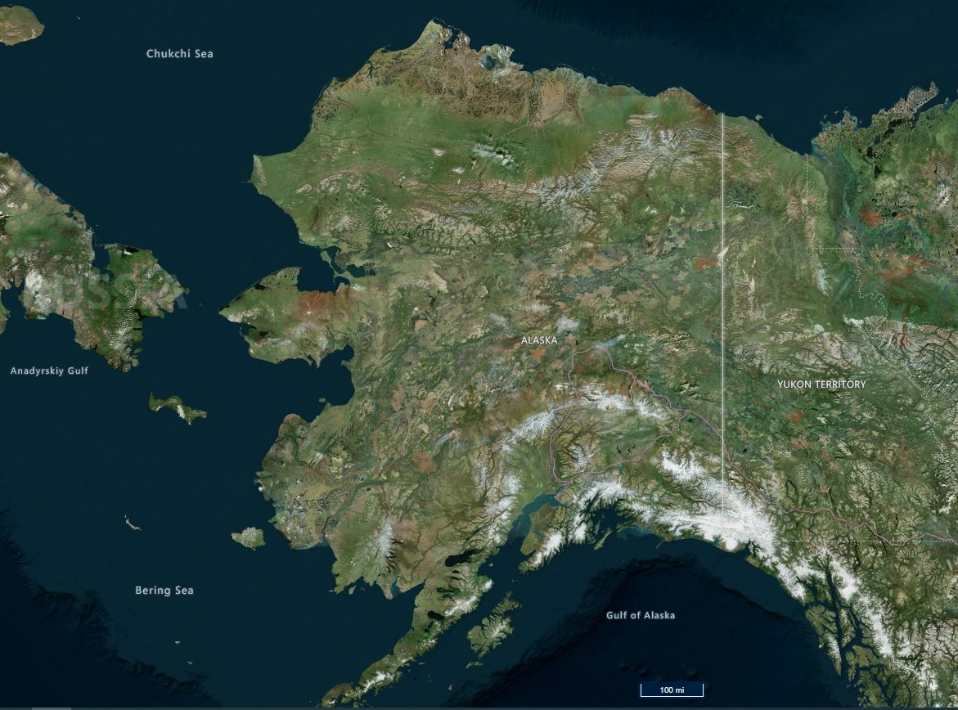
ALASKA’S ORPHAN WELLS
Shaviovik Unit 1
Shaviovik Unit 1
Gubik Unit 1
Gubik Unit 1
Eureka 1
Chickaloon 1
Eureka 1
Chickaloon 1
Rosetta 1, 2, 3, 4
Rosetta 1, 2, 3, 4
Middle Lk Unit 1A
Middle Lk Unit 1A
Alaska Gulf 1
Alaska Gulf 1
Chilkat No. 25
Key
Iniskin Peninsula
Chilkat No. 25
Sullivan Phillips 1
Iniskin Peninsula
Sullivan Phillips 1
On State, Native,
or Private Lands:
Eureka 1
Alaska 1
Eureka 1
Finnegan 1
On Federal Lands:
Lee 1 (?)
Alaska 1
AOGCC January 18, 2022
Illustration Source: AK DNR, Alaska Mapper, Bing Hybrid Base Map

Slide 5
Number of Orphan Wells on State and Private Lands
AOGCC has identified the following wells on State and Private Lands in Alaska
  8 wells in Southcentral Alaska.
  1 or 2 wells on the North Slope (one of these may not be an orphan)
  1 or 2 wells in Southeast between Katalla and Yakutat (one of these may not be an orphan)
  6 wells on Iniskin Peninsula. Not enough is known about these wells. Initial grant funding will be used to investigate.

Slide 6
Rosetta 1&2 Site Survey

Slide 7
Middle Lake Site Survey

Slide 8
Eureka Site Survey

Slide 9
Title Searches
DNR has completed title searches on the known orphan wells. Will be included in the well files.
Some of the wells may fall off the orphan wells list if the responsible operator can be identified.
  Sullivan Phillips #1
  Gubik Unit #1
Wells may be added to the list.

Slide 10
DEC Recommendations
Reserve Pit Closure per DEC regulations – if present
  Presence of reserve pits has not been confirmed in most cases.
Methane monitoring – Pre & Post-plugging
Surface water sampling within 250’ of the well
Water well sampling within 200’ of the well
Qualified Environmental Professional (QEP) to develop a work plan for approval of DEC Contaminated Sites Program

Slide 11
Scope and Priorities
Priority #1: Plug and Abandon the wells and perform site clearance per AOGCC regulation.
Priority #2: Close active reserve pits, if present
Priority #3: Remediate contaminated sites – Most likely will not be done with initial grant funding.

Slide 12
RFP Format
CMGC contract – Progressive Design Build
Successful bidders will be Project Managers
Accepted according to their cost structure and demonstrated ability to complete the scope of work.
Once the contract has been awarded, the contractor makes plans and cost estimates for plugging each well.
AOGCC will review each plugging proposal for:
  Technical quality/feasibility
  Adherence to AOGCC regulations
  Will use an independent cost estimator to vet cost estimates.

Slide 13
Orphan Wells RFP
RFP will be advertised on DOT construction bidding site: https://dot.alaska.gov/procurement/awp/awp-bids.cfm
RFP also advertised on AOGCC website.
Bids will be submitted via email to DOT Contracts section. Instructions will be in the RFP. No need to do anything with AASHTOWare.
Recent DOT example if they want to get familiarized: https://www.bidx.com/ak/letting?lettingid=NSHWY00657CMGC_1

